Slide 1
William Stallings
Computer Organization and Architecture
6th Edition
Chapter 9
Computer Arithmetic

Slide 2
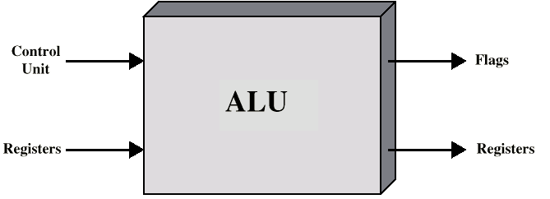
Arithmetic & Logic Unit
Does the calculations
Everything else in the computer is there to service this unit
Handles integers
May handle floating point (real) numbers
May be separate FPU (maths co-processor)
May be on chip separate FPU (486DX +)
Human: -1101.0101₂ = -13.3125₁₀

Slide 3
Integer Representation
Only have 0 & 1 to represent everything
Positive numbers stored in binary
  e.g. 41=00101001=32+8+1
No minus sign
No period
Sign-Magnitude
Two’s compliment

Slide 4
Sign-Magnitude
Left most bit is sign bit
0 means positive
1 means negative
+18 = 00010010
-18 = 10010010
Problems
  Need to consider both sign and magnitude in arithmetic
  Two representations of zero (+0 and -0)
+18 = 00010010
-18 = 10010010

Slide 5
Two’s Compliment
+3 = 00000011
+2 = 00000010
+1 = 00000001
+0 = 00000000
-1 = 11111111
-2 = 11111110
-3 = 11111101

Slide 6
Benefits of Two’s Compliment
One representation of zero
Arithmetic works easily (see later)
Negating is fairly easy
  3 = 00000011
  Boolean complement gives 11111100
  Add 1 to LSB 11111101

Slide 7
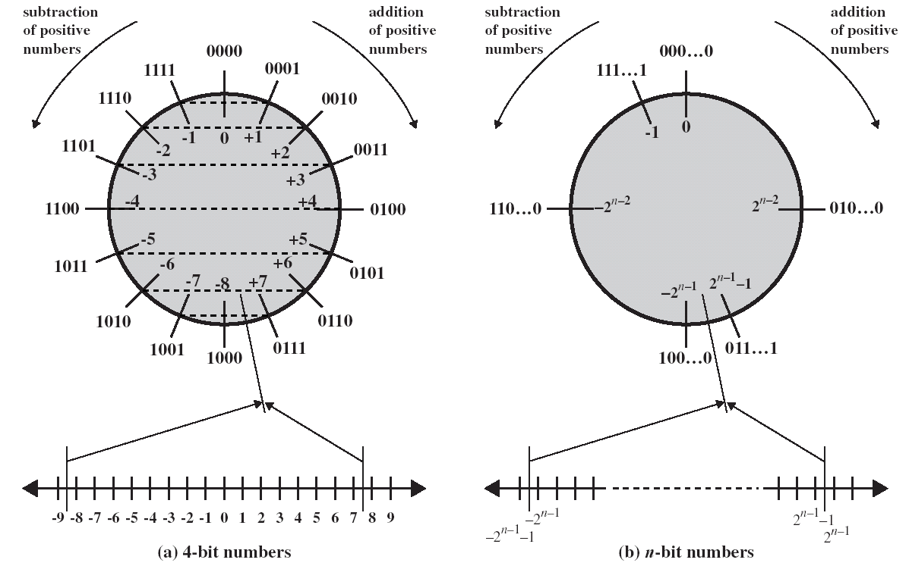
Geometric Depiction of Twos Complement Integers

Slide 8
Range of Numbers
8 bit 2s compliment
  +127 = 01111111 = 2⁷ -1
  -128 = 10000000 = -2⁷
16 bit 2s compliment
  +32767 = 011111111 11111111 = 2¹⁵ - 1
  -32768 = 100000000 00000000 = -2¹⁵
Value range for an n-bit number
Positive Number Range: 0 ~ 2^{n-1}-1
Negative number range: -1 ~ - 2^{n-1}

Slide 9
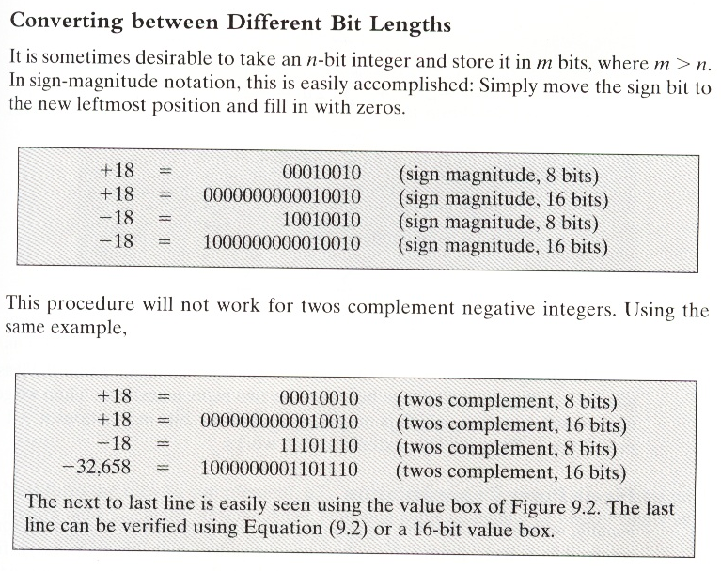
Range of Numbers

Slide 10
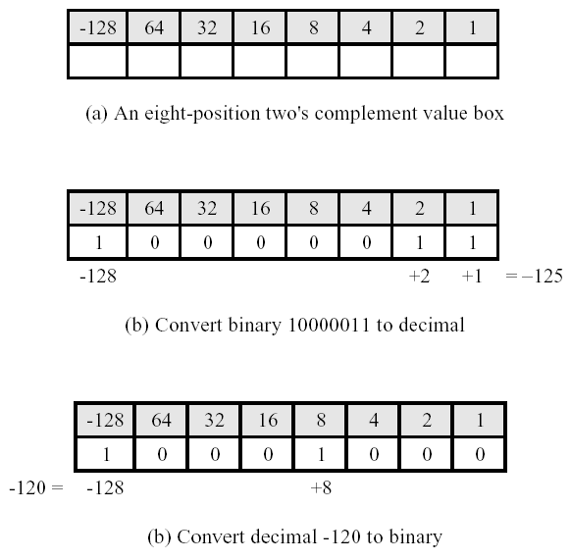
Conversion Between Lengths
Positive number pack with leading zeros
+18 = 00010010
+18 = 00000000 00010010
Negative numbers pack with leading ones
-18 = 11101110
-18 = 11111111 11101110
i.e. pack with MSB (sign bit)

Slide 11
Addition and Subtraction
Normal binary addition
Monitor sign bit for overflow
Take twos compliment of subtrahend and add to minuend
  i.e. a - b = a + (-b)
So we only need addition and complement circuits

Slide 12
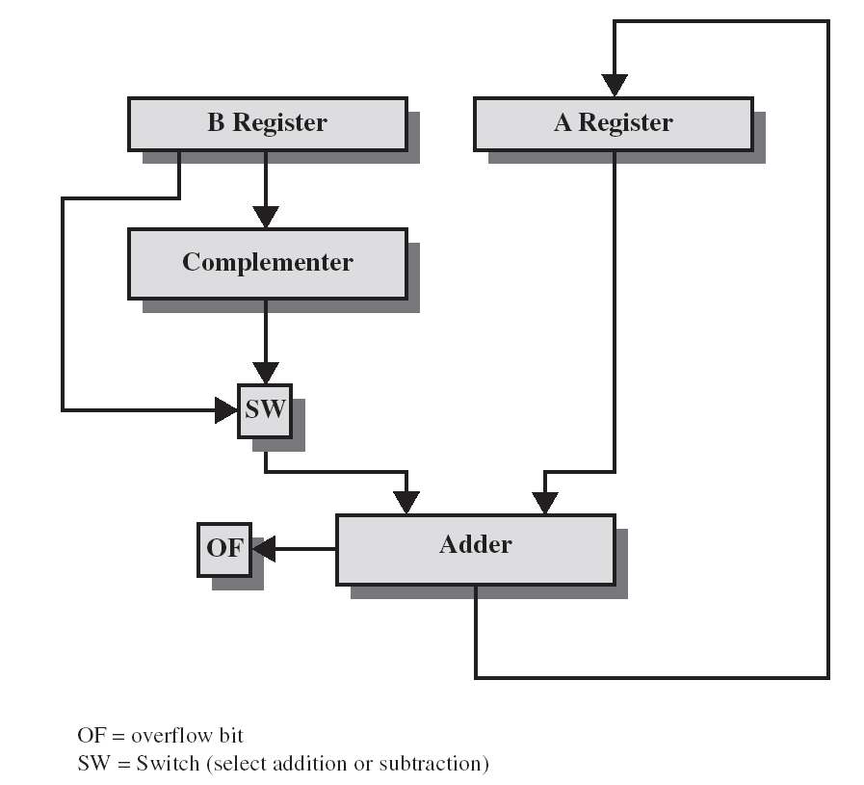
Hardware for Addition and Subtraction

Slide 13
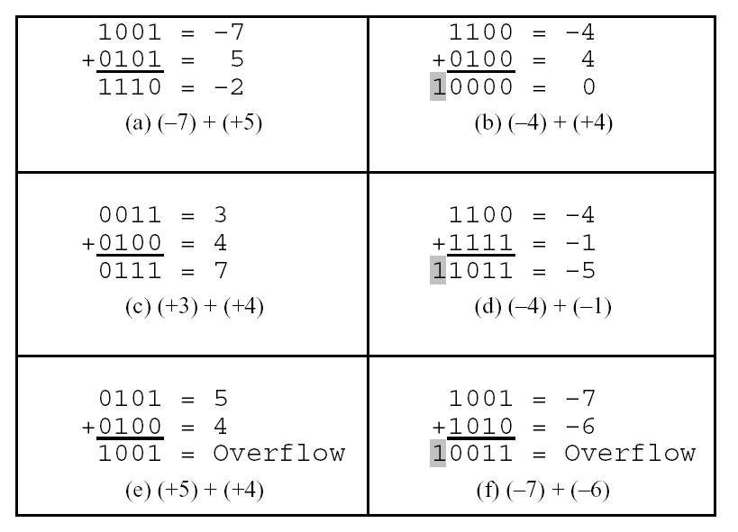

Slide 14
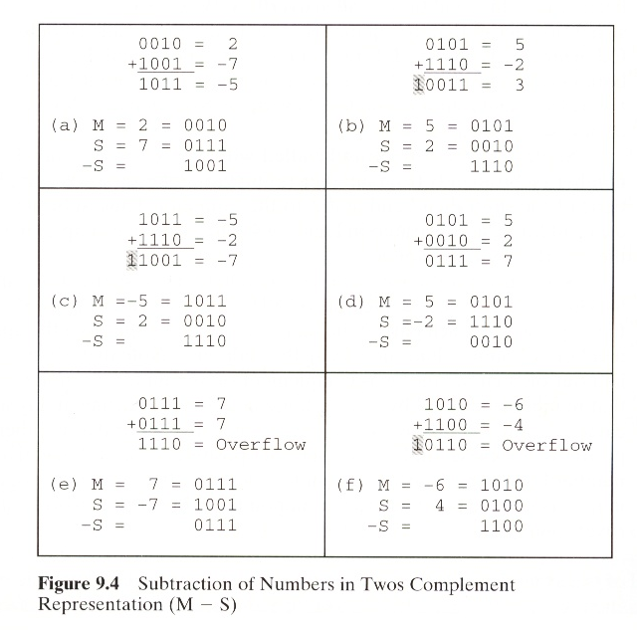

Slide 15
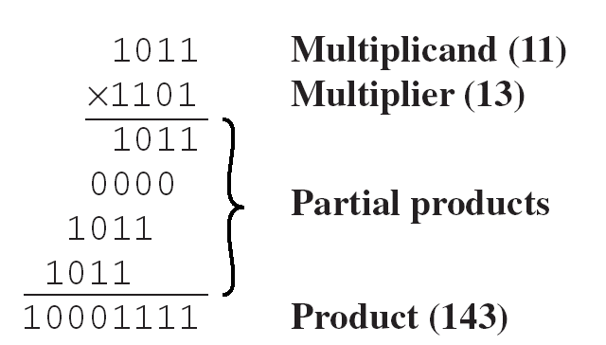
Multiplication
Complex
Work out partial product for each digit
Take care with place value (column)
Add partial products
Note: need double length result

Slide 16
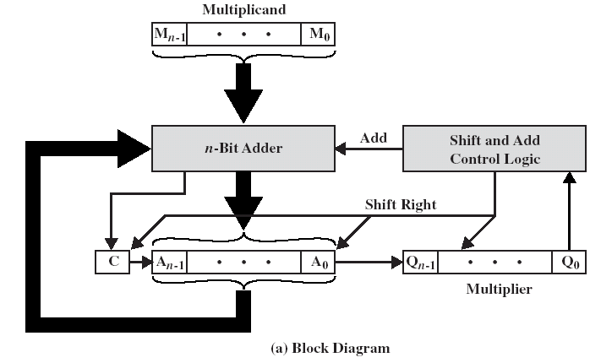
Unsigned Binary Multiplication

Slide 17
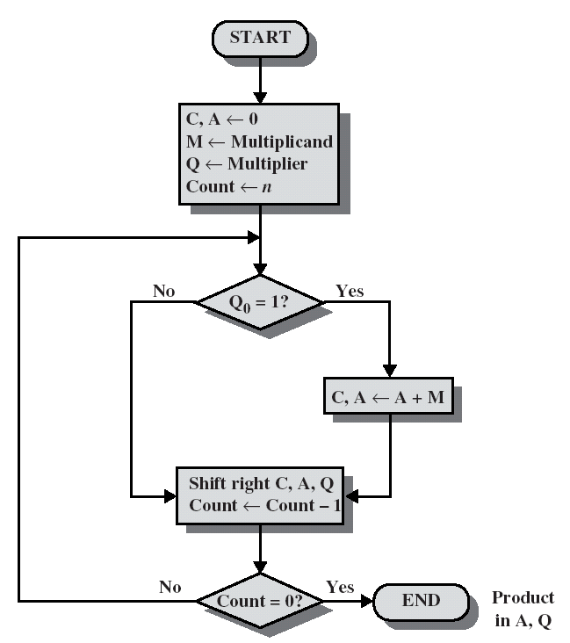
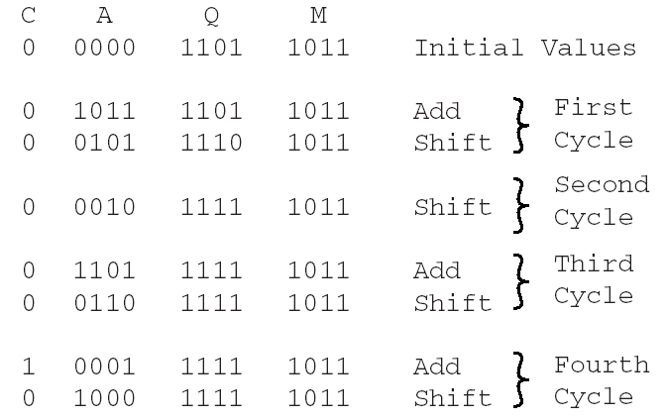
Flowchart for Unsigned Binary Multiplication

Slide 18
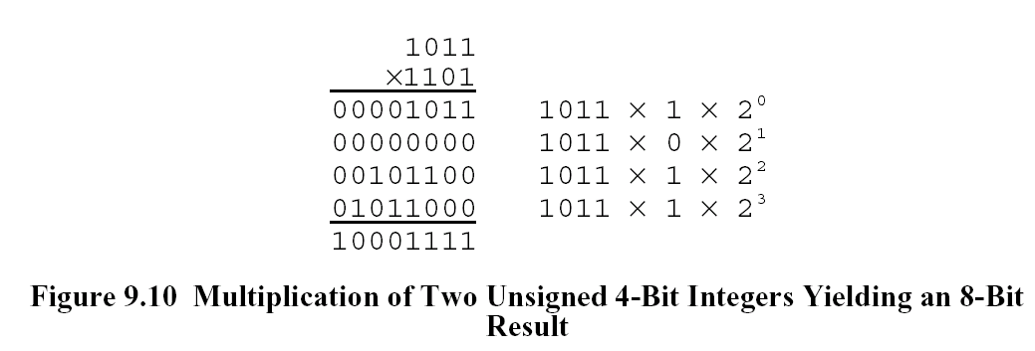
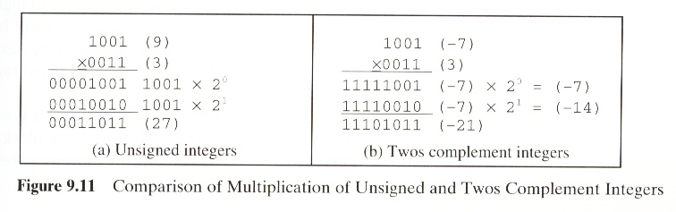
Multiplying Negative Numbers
This does not work!
Solution 1
  Convert to positive if required
  Multiply as above
  If signs were different, negate answer
Solution 2
  Booth’s algorithm

Slide 19
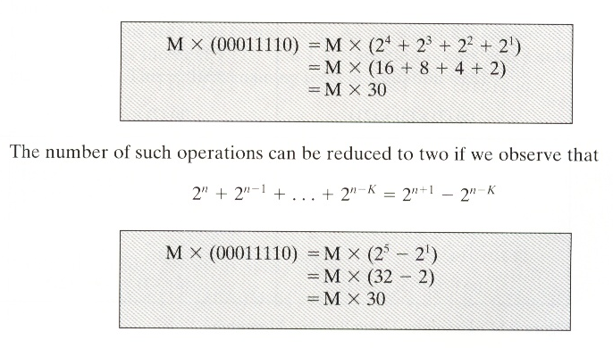
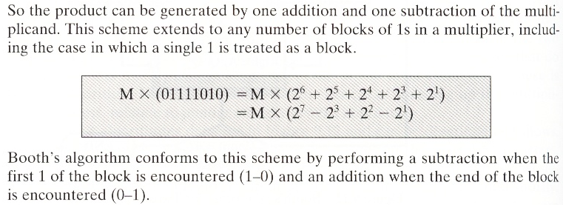

Slide 20
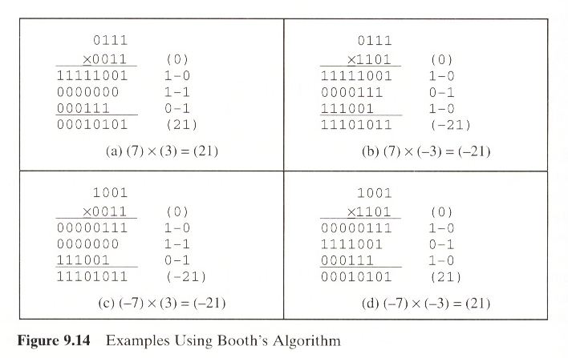

Slide 21
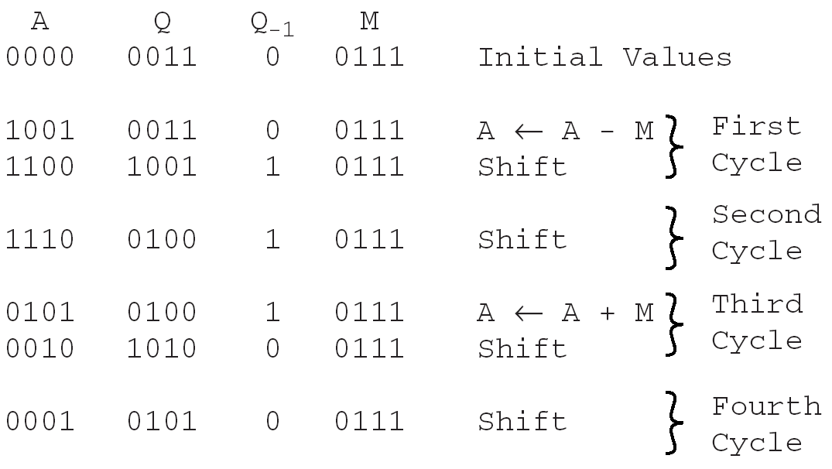
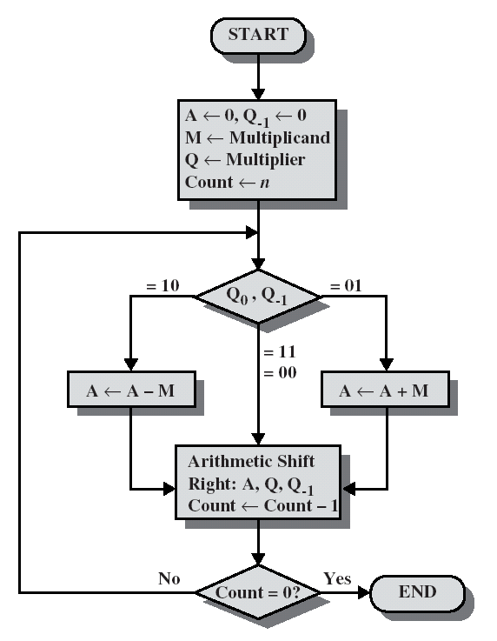
Booth’s Algorithm

Slide 22
Division
More complex than multiplication
Negative numbers are really bad!
Based on long division

Slide 23
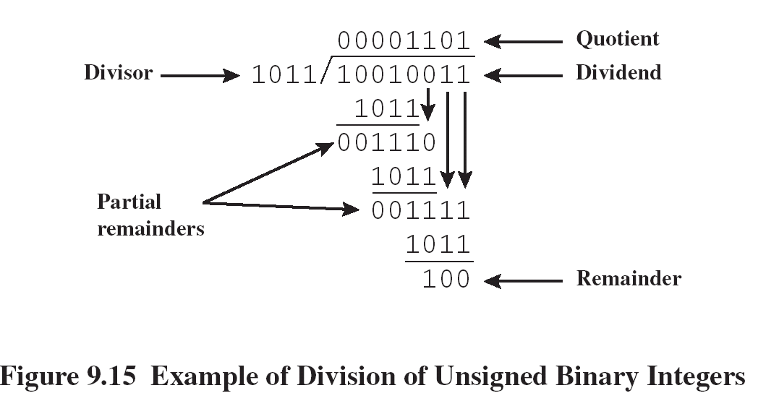
Division of Unsigned Binary Integers

Slide 24
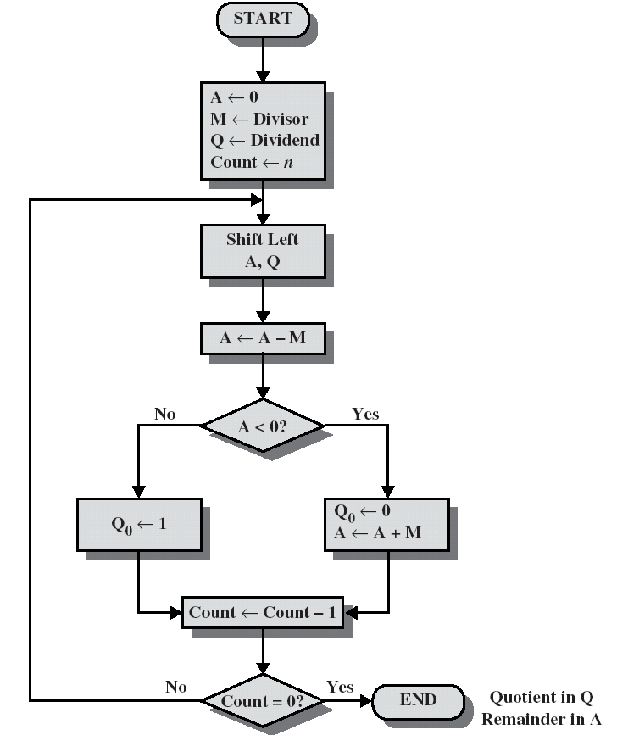
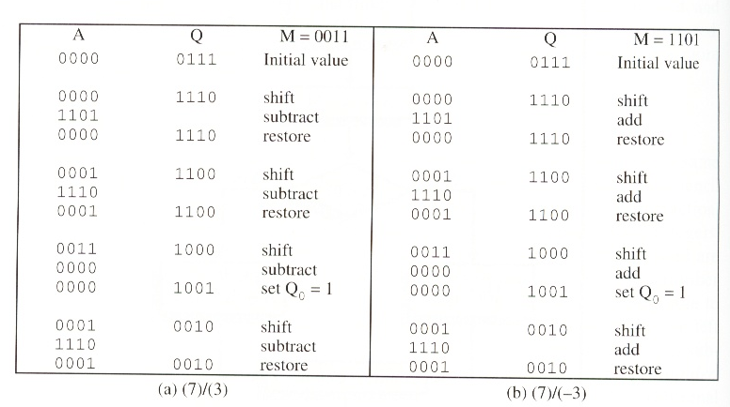
Flowchart for Unsigned Binary Division

